Slide 1
Cloud Server Three Ways
Tavis Aitken

Slide 2
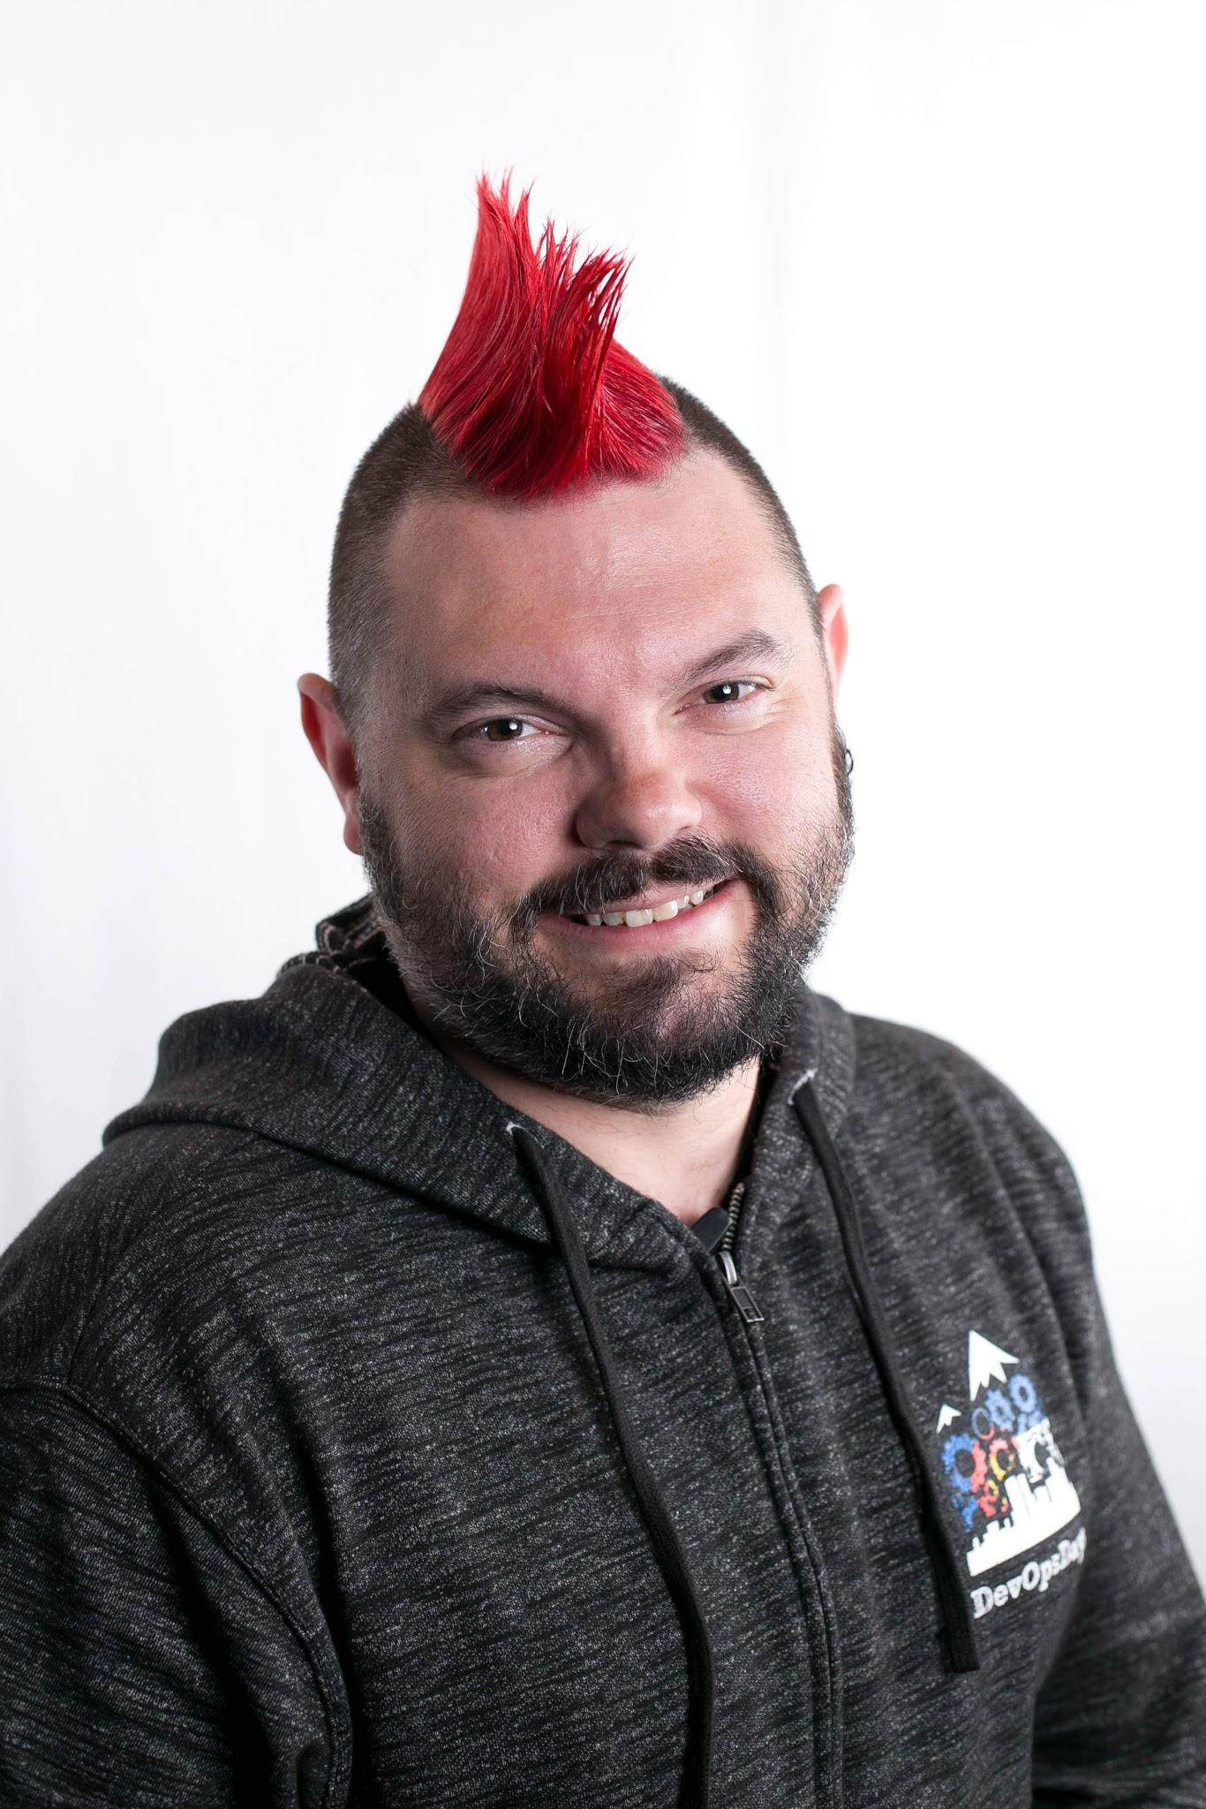





Who Am I?
@Tavisto

Slide 3
Choose a Cloud Provider

Slide 4
Just a few to choose from
Amazon Web Services
Google Cloud Platform
Microsoft Azure
Digital Ocean
IBM Cloud
Oracle Cloud Infrastructure
And many many more

Slide 5
Google Cloud Platform

Slide 6
Set up a project

Slide 7
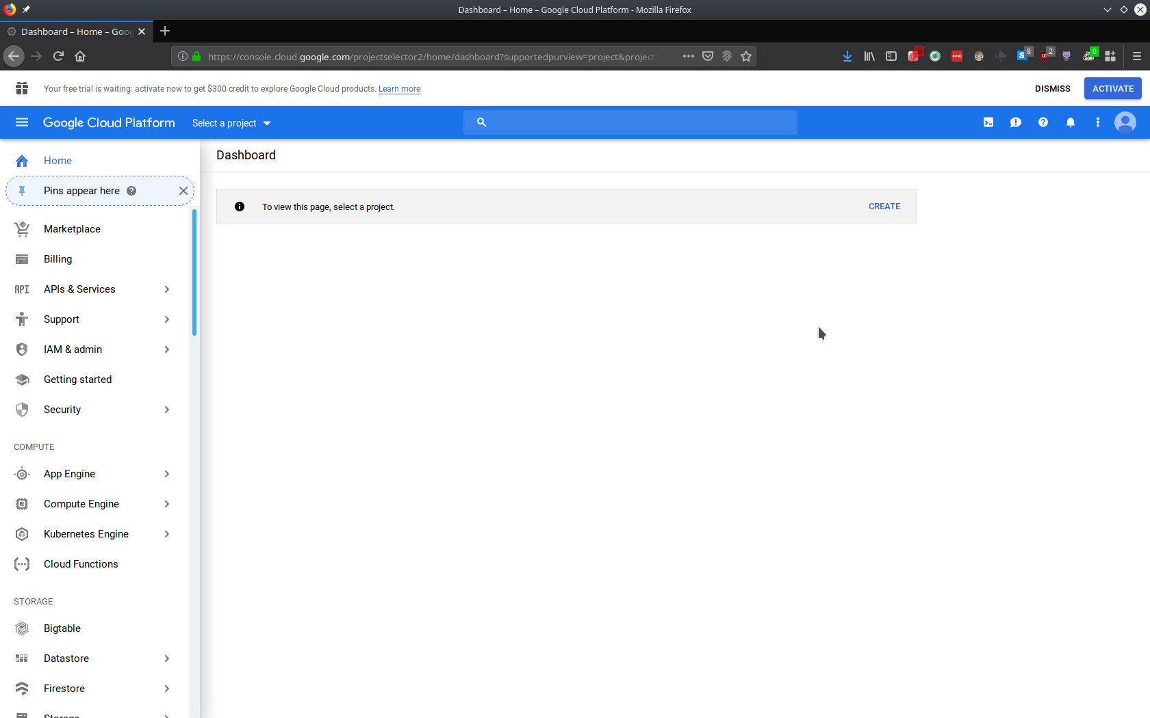

Slide 8
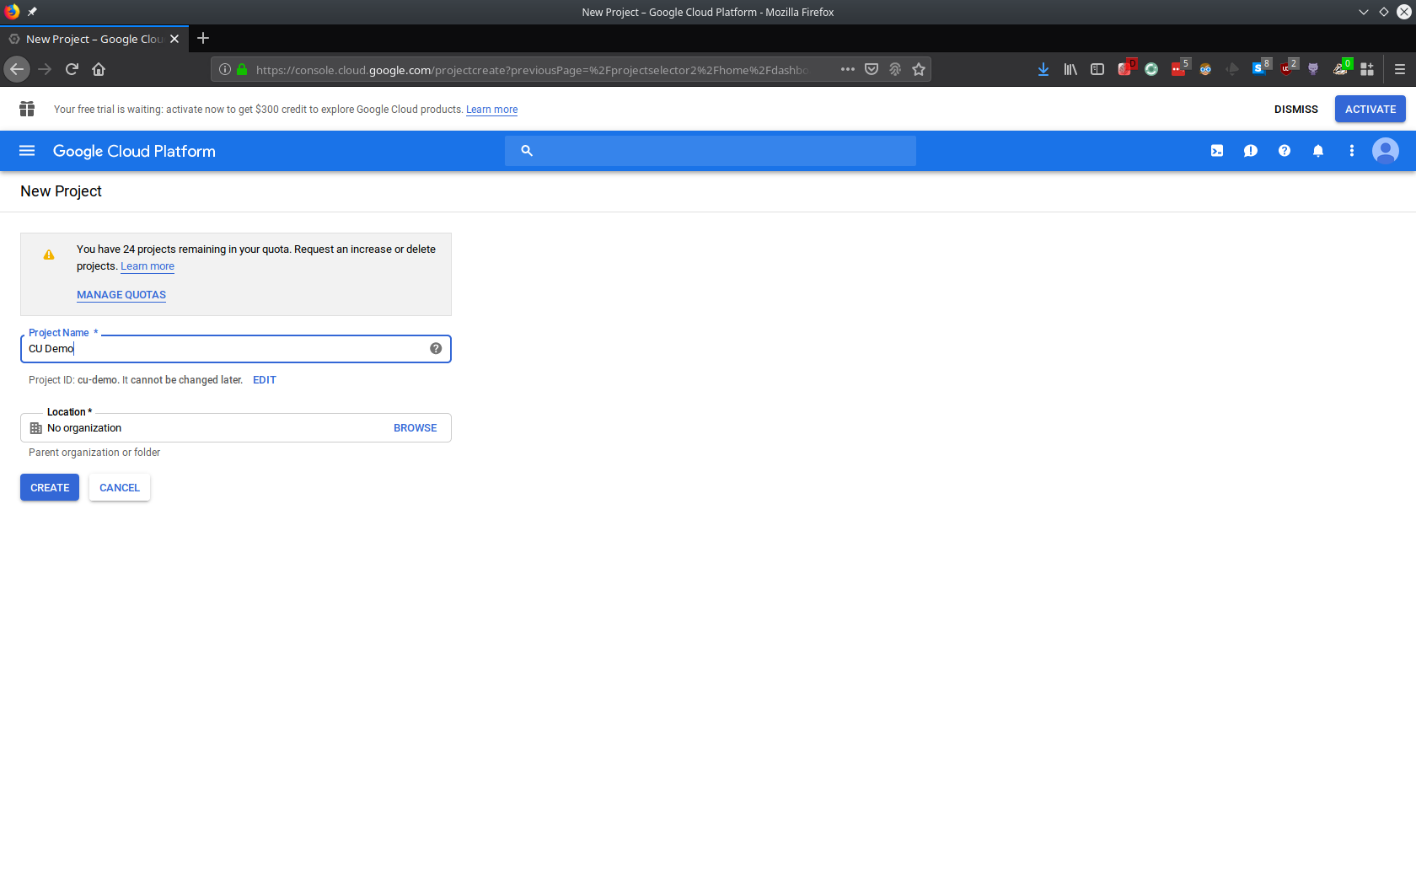

Slide 9
Use the console

Slide 10
LIVE DEMO HERE!

Slide 11
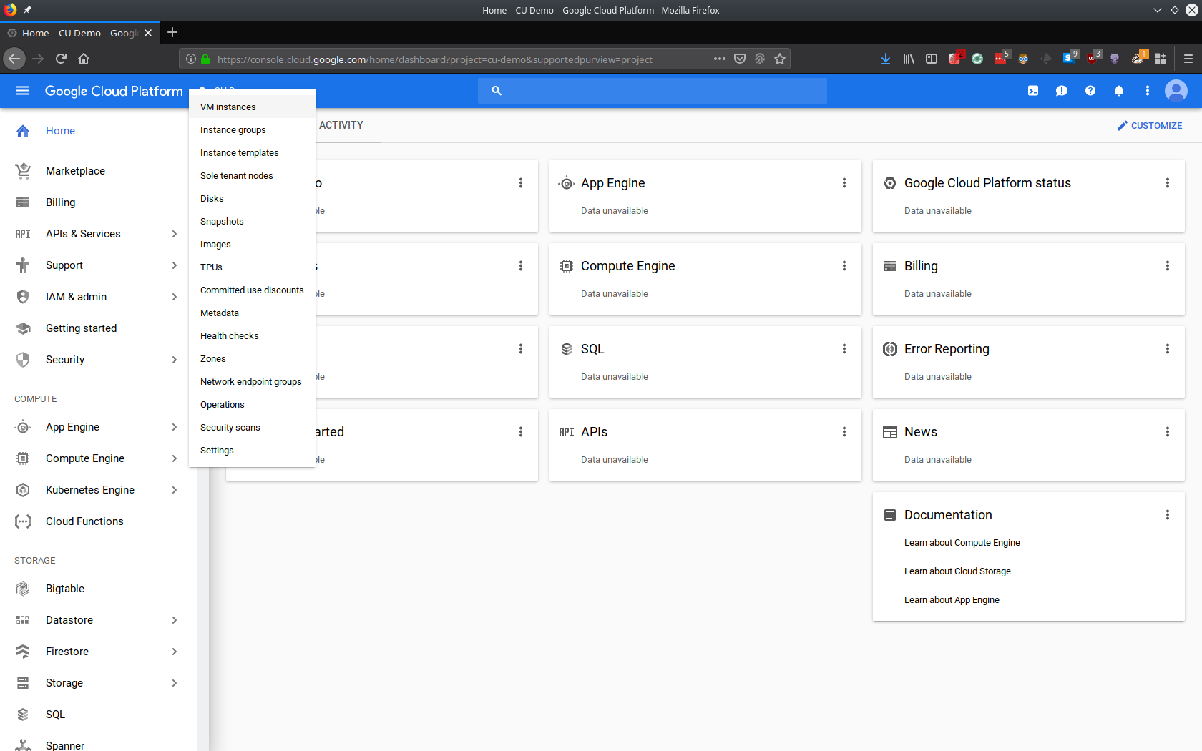
Start up a compute Instance

Slide 12
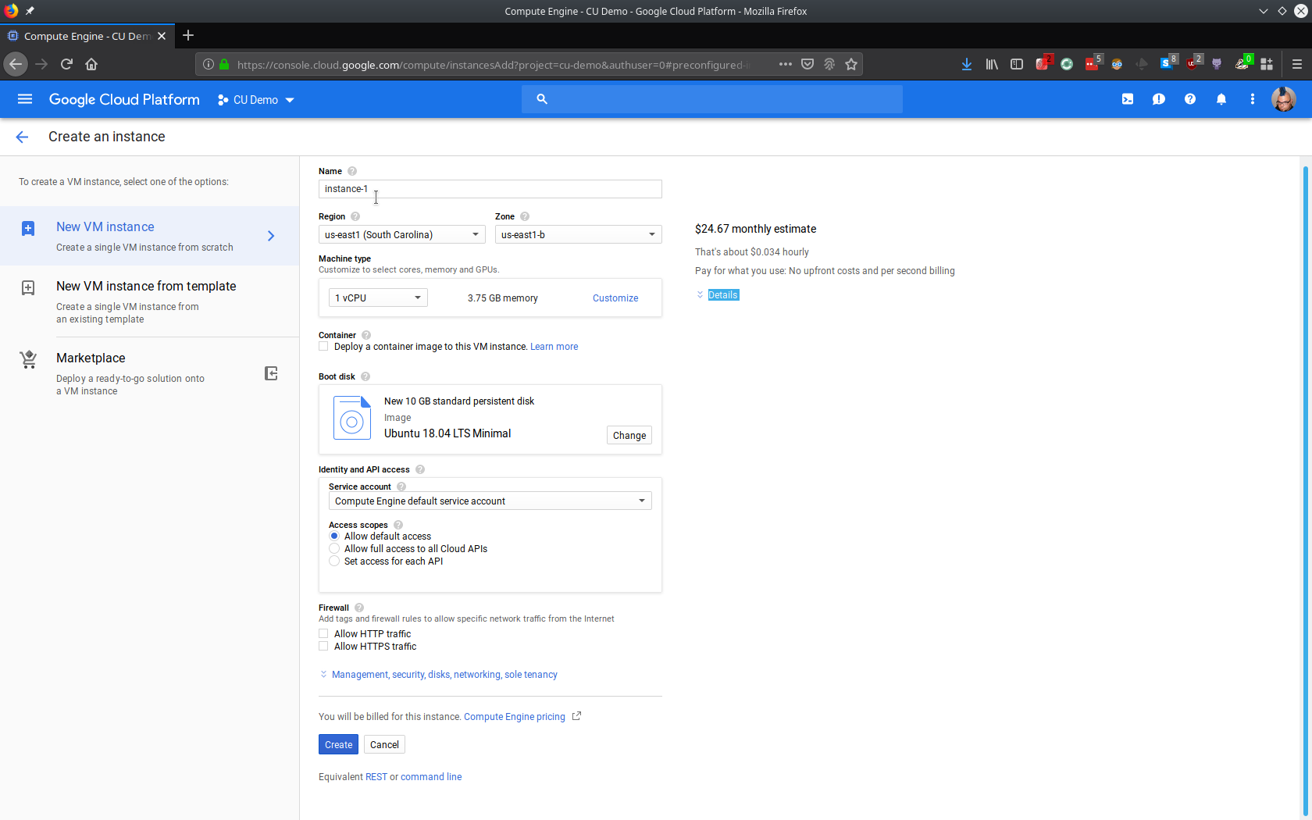
Choose Your Size, Image, Permissions and the like

Slide 13
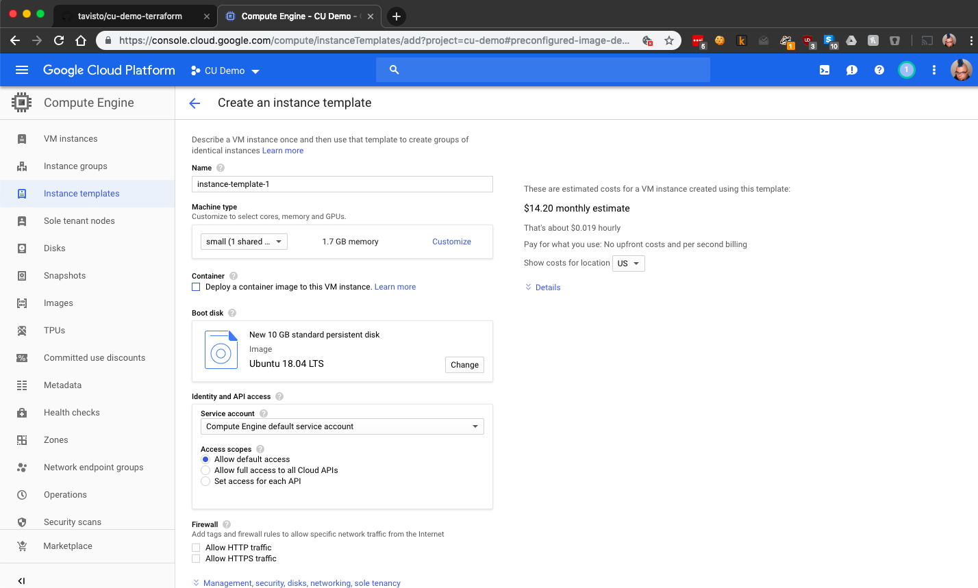
Create a template to use the same settings

Slide 14
Use the command line utilities

Slide 15
LIVE DEMO HERE!

Slide 16
Automate with code

Slide 17
Infrastructure as Code
Cloud Resource Management
Configuration Management
Terraform - All Cloud Providers
Cloud Formation - AWS
Cloud Deployment Manager - Google
Ansible
Puppet
Chef
SaltStack
Cloud Init
A whole bunch of bash scripts

Slide 18
Terraform

Slide 19
LIVE DEMO HERE!

Slide 20
Resources
https://pages.awscloud.com/NAMER-field-OE-AWSome-Day-Online-March-2020-reg-event.html
https://cloud.google.com/training/data-ml
https://cloud.google.com/sdk/docs/install
https://cloud.google.com/docs/terraform

Slide 21
Thanks!
https://github.com/tavisto/cu-demo
https://www.devopsdays.org/denver

